Slide 1


Connected Automotive System
A multifunctional system for existing cars to facilitate improvement in monitoring, performance and safety.

Slide 2
Current Challenges
Technical issues related to the components of the car in terms of Engine Temperature, Tyre Pressure, Fuel Tank Capacity and efficiency, Interior temperature and humidity, etc.
Lack of Driver Health issues monitoring with respect to fatigue level, well-being, slumping, etc.
Safety of the commuter and the car with respect to service and repairing, over-speeding, etc.
Security of the car and danger of theft.
Lack of alert mechanism to the owner about the car.

Slide 3


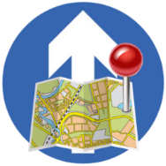
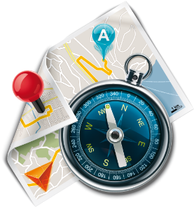
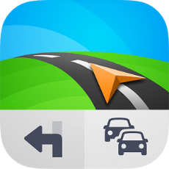


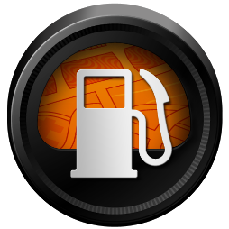

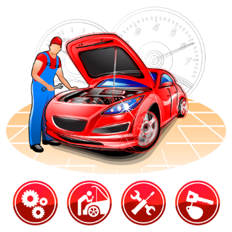


Our SOLUTION
Geo Fencing
Diagnostic Services
Route Disruption Management
GPS Tracking
Navigation
Real Time Alerts
Stolen Vehicle Tracking
Fuel Management
Traffic Status
Predictive Maintenance
Driver Monitoring
Journey Analysis

Slide 4
Geo Fencing
Profile creation with geo fences.
Vehicle Immobilization/ Lock.
Real time alerts and notifications on crossing geo fence.
GPS Tracking and Navigation
Location tracking.
Time stamp and analysis.
Distance Calculation.
Route tracking and deviation monitoring.
Real time alerts and notifications.

Slide 5
Stolen Vehicle Tracking
Theft Alerts.
Vehicle Immobilization/ Lock.
Fuel supply locking.
Real time alerts and notifications.
Predictive Maintenance
Status and trends of performance parameters of car components.
Identification of anomalies in functioning or failure of components.
Nearest garage search.
Self Help with recommendation ( cost / service station)
Accident or Breakdown management.
Notification to service personnel.
Maintenance records.
Real time alerts and notifications.

Slide 6
Diagnostic Services
Malfunction indication and severity of components.
Speed Tracking.
Fuel Tank Monitoring.
Monitoring of over-heating of engine temperature.
Fog detection on windshield.
Smoke detection around components of the car.
Tyre Pressure status check.
Fault and service history.
Real time alerts and notifications.

Slide 7
Fuel Management
Fuel cost and analysis.
Fuel consumption and efficiency analysis.
Fuel status and recommendation.
Refilling locations and recommendations.
Real time alerts and notifications.
Driver Monitoring
Driver profile and score card.
Driving parameter details.
Driving condition monitoring and guidance.
Driver health monitoring (fatigue, slumping, alertness, etc.).
Real time alerts and notifications.

Slide 8
Route Disruption Management
Emergency services management.
Road side assistance management.
Re-routing options in case of any hindrance in the path. (Natural calamity, Political unrest, etc).
Real time alerts and notifications.
Driver Monitoring
Driver profile and score card.
Driving parameter details.
Driving condition monitoring and guidance.
Driver health monitoring (fatigue, slumping, alertness, etc.).
Real time alerts and notifications.

Slide 9
Traffic Status
Traffic information.
Re-routing options.
Real time alerts and notifications.
Journey Analysis
Route / segment wise reporting.
Journey parameters analysis and reporting.
Track route and driving patterns.
Real time alerts and notifications.

Slide 10
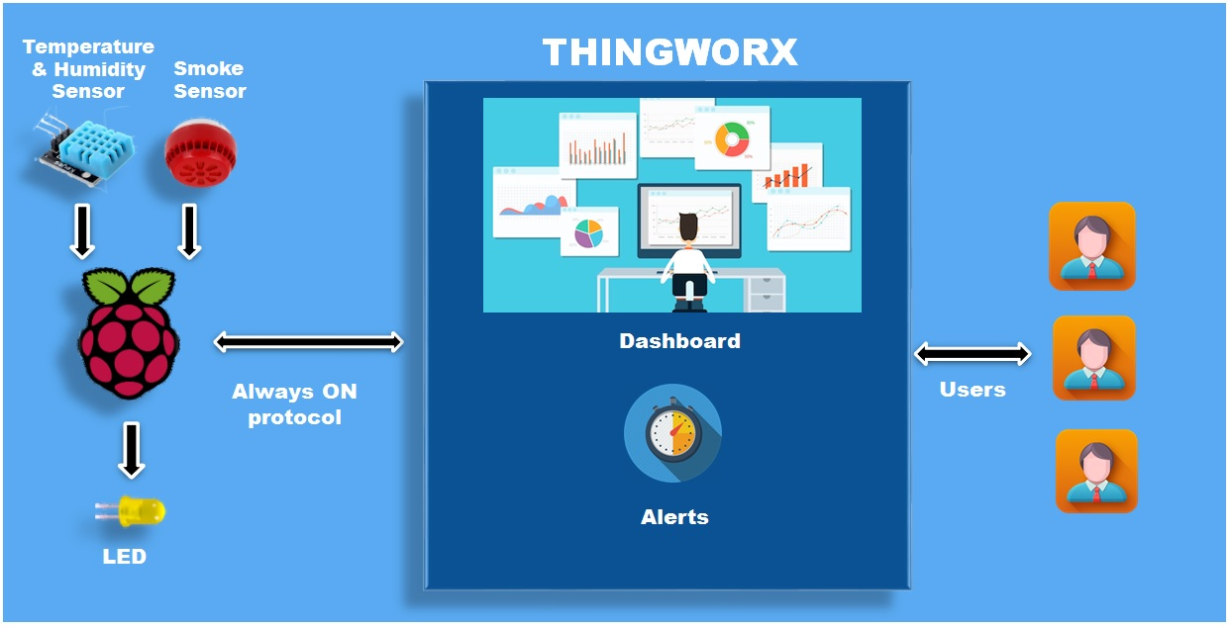
Architecture

Slide 11
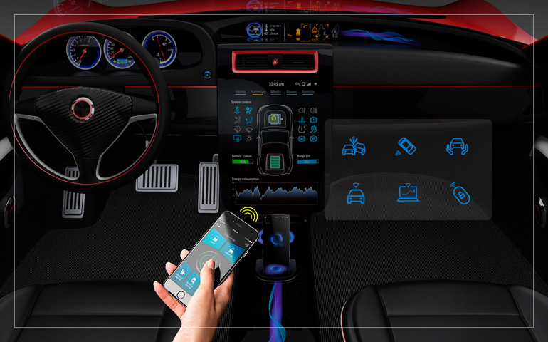
THANK YOU

